Slide 1
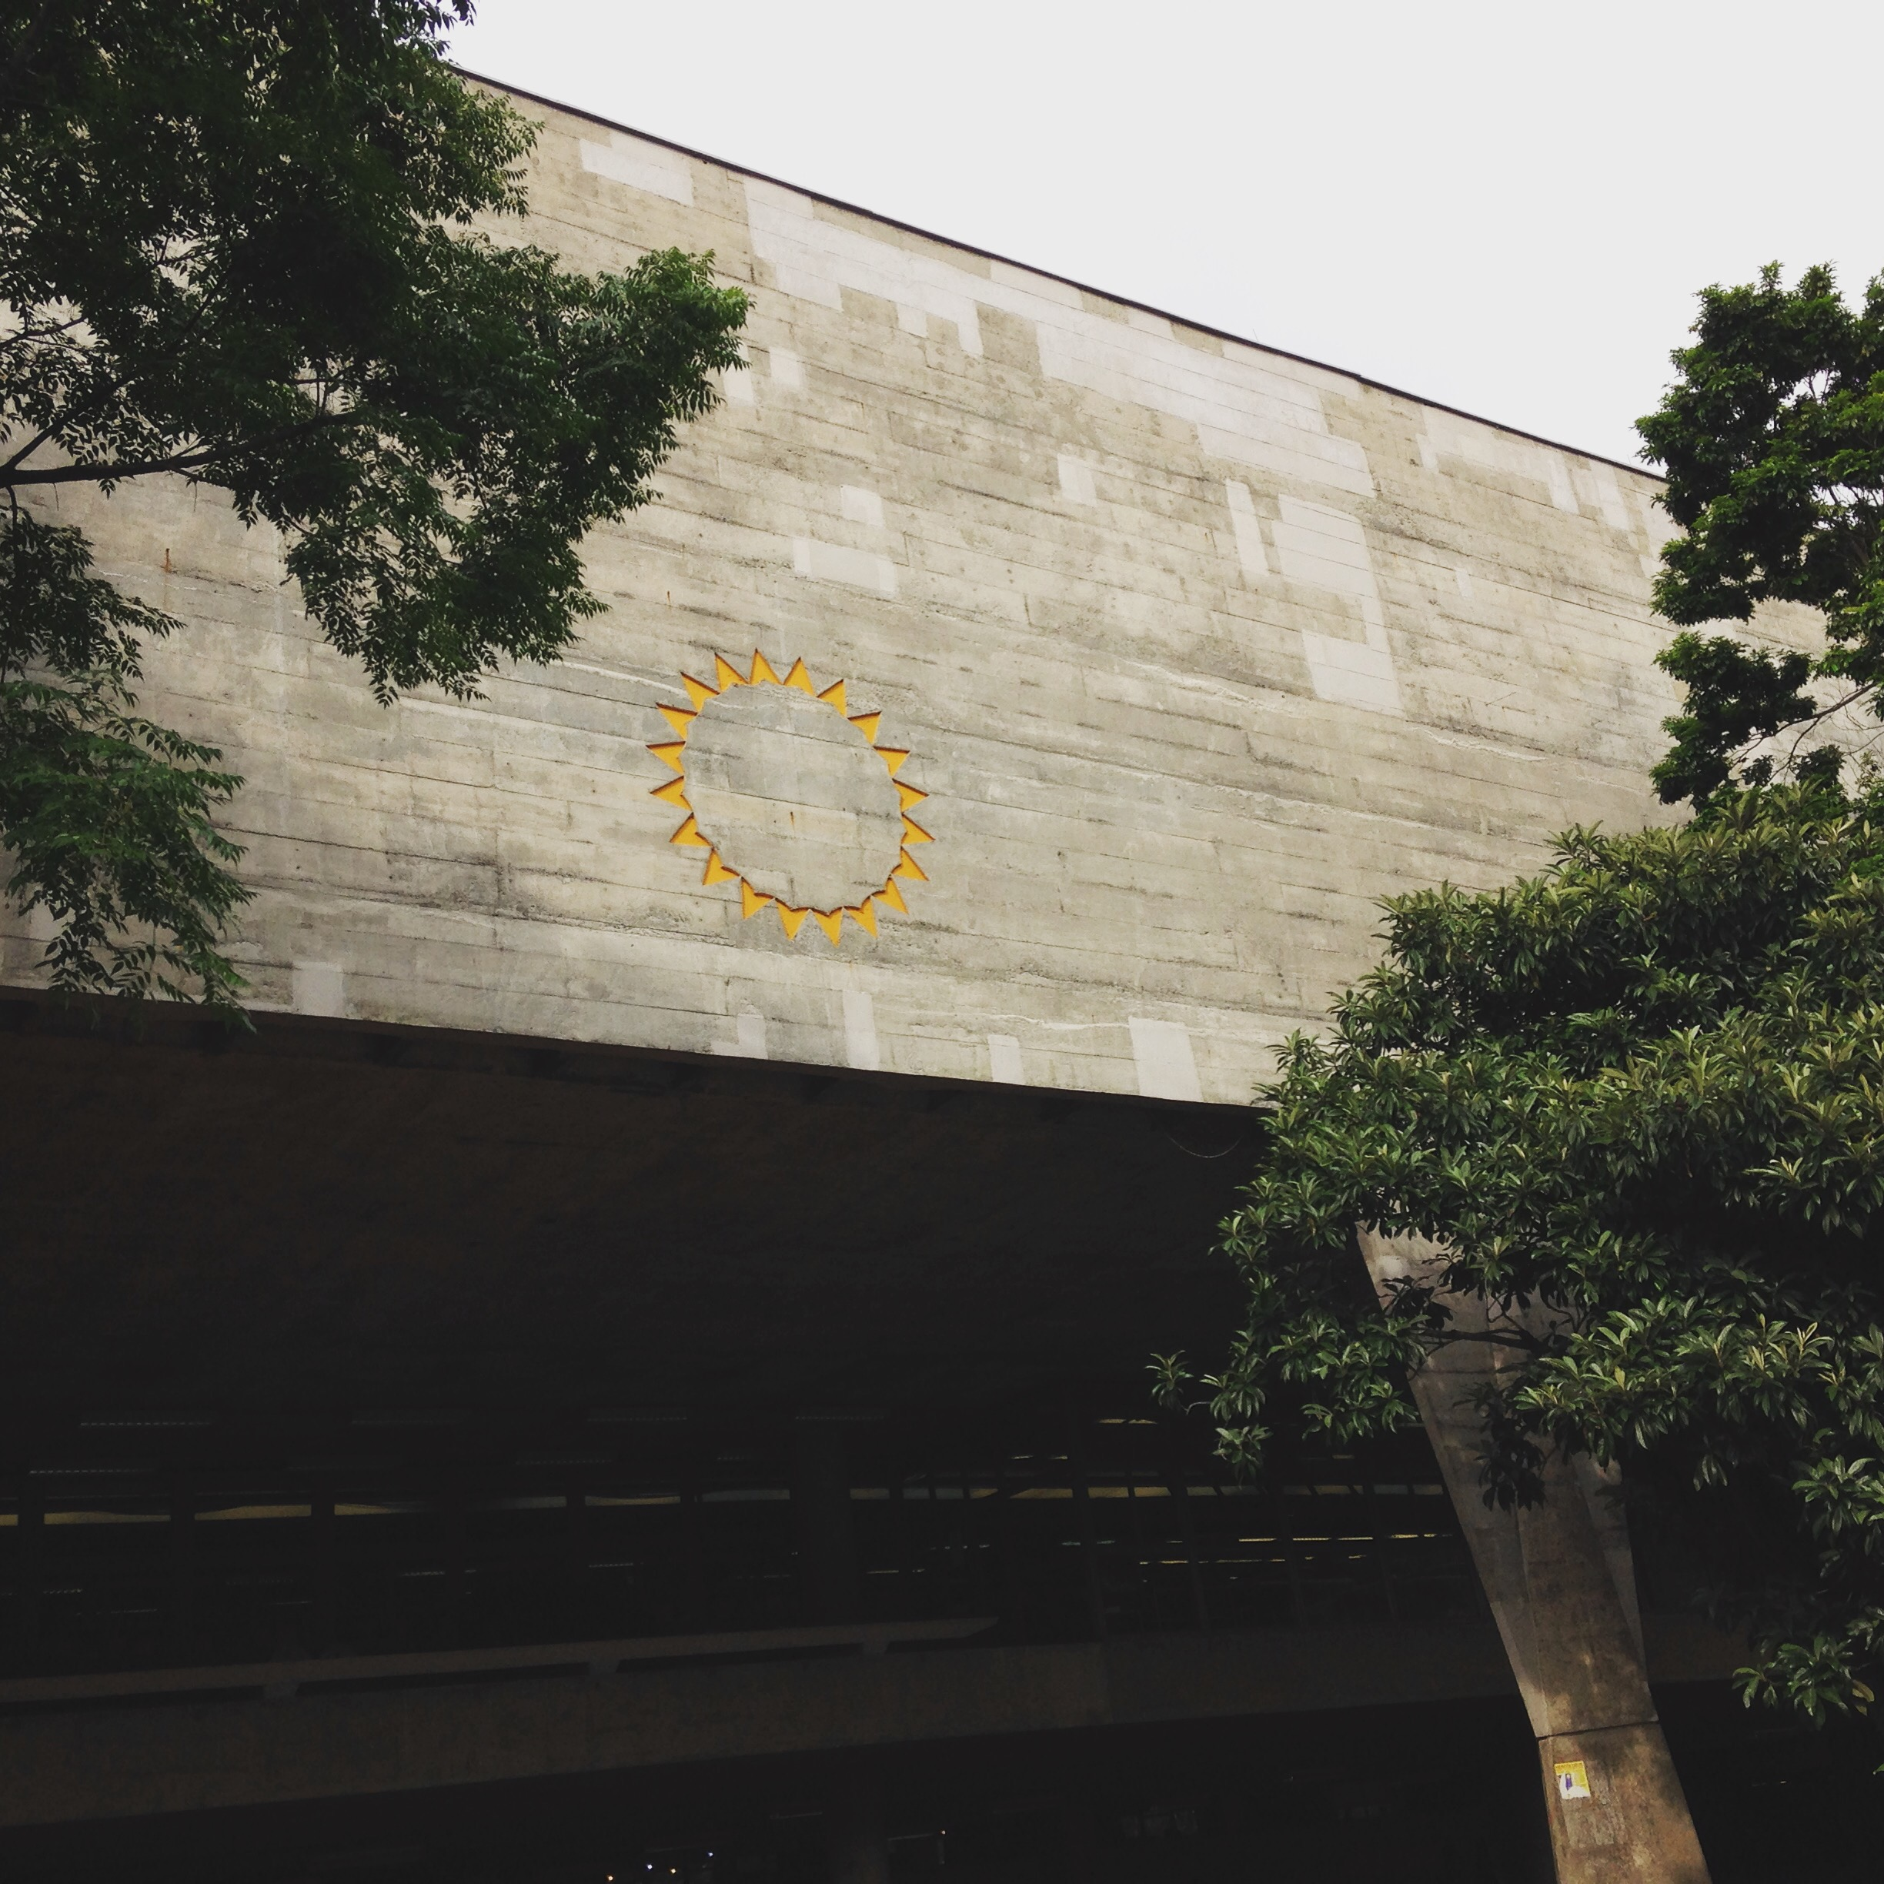
FACTSHEET FAUUSP
YEAR 2023 / 2024 - MOBILITY INCOMING
Address: Rua do Lago, 876 Butantã - São Paulo – SP ZIPCode: 05508-080 Maps: https://goo.gl/maps/9wQXEiPu1cn4mod27

Slide 2
Faculdade de Arquitetura e Urbanismo da Universidade de São Paulo School of Architecture and Urbanism of University of São Paulo
International Office Administrative Core * Ms. Fernanda Shoshi Incoming Students International Agreement Institucional Affairs International.fau@usp.br * Ms. Maria Vilani Cezar Incoming Students incoming.fau@usp.br * Mr. Rodrigo Winther Outgoing Students outgoing.fau@usp.br
International Office Academic Council * Prof.ª Priscila Lena Farias President International.fau@usp.br prifarias@usp.br * Prof. Gustavo Curcio Vice-President international.fau@usp.br curcio@usp.br
OFFICE HOURS
Administrative Core Service: Monday to Friday, from 9:00 am to 6:00 pm (Brasília time)
We request that all contact be made by email, for recording and memory of interactions.

Slide 3
Academic Information
LANGUAGE:
Language in classes: Portuguese
Proficiency level: We advise students to have an intermediate level of Portuguese (B1 or B2). Not only to accompany classes, but for communication in general, as in São Paulo few people speak any language other than Portuguese.
Language course: The exchange student can attend (during the semester) an intensive Portuguese course offered by the Language Learning Center (Centro de Línguas da FFLCH). For further information, please visit http://clinguas.fflch.usp.br/ or send an email to portcl@usp.br
FAUUSP PROGRAMS:
Undergraduate Programs
Architecture and Urbanism
Design
Graduate Programs (MSc and PhD)
Technology of Architecture
History and Fundamentals of Architecture and Urbanism
Design and Architecture
Landscape and Environment
Project, Space and Culture
Habitat
Architectural Project
Urban and Regional Planning
OBS.: The FAUUSP Architecture and Design undergraduate program last for 5 years. Therefore, students of the "Master" cycle degree (according to the Bologna Treaty) are recognized at USP as undergraduate students. For that reason, these students MUST attend classes at the undergraduate level course.

Slide 4
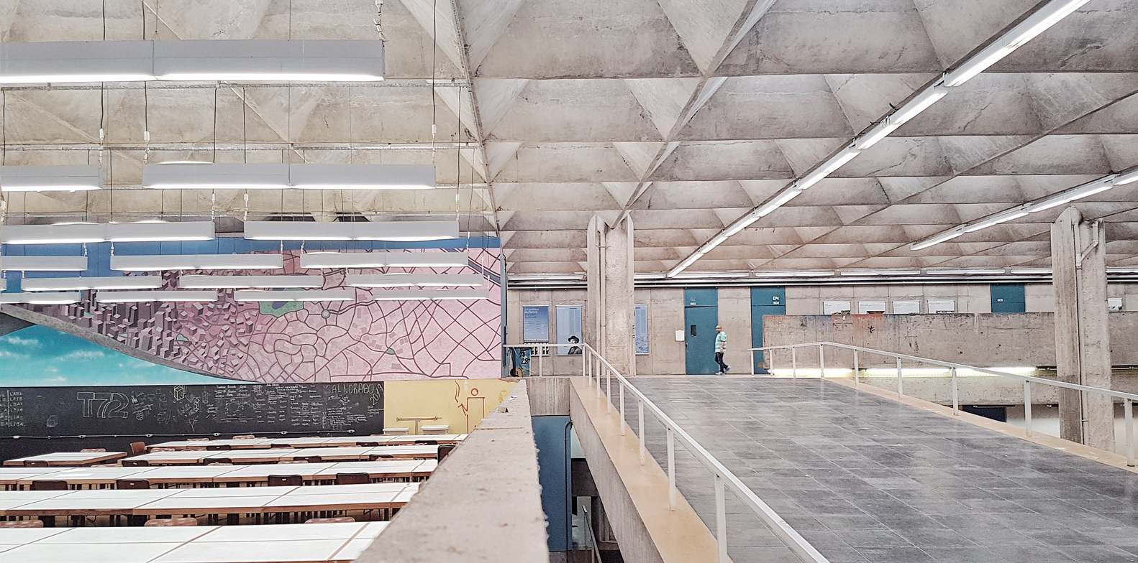
Academic Information
ACADEMIC CURRICULUM (in Portuguese):
Architecture: https://uspdigital.usp.br/jupiterweb/listarGradeCurricular?codcg=16&codcur=16011&codhab=0&tipo=N
Design: https://uspdigital.usp.br/jupiterweb/listarGradeCurricular?codcg=16&codcur=16100&codhab=4&tipo=N
Graduate Programs: https://uspdigital.usp.br/janus/componente/disciplinasOferecidasInicial.jsf?action=1&tipo=T&codcpg=16
CALENDAR:
1st Semester: February to July
Start of Semester: 26/February/2024
End of Semester: 02/July/2024
2nd Semester: August to December
Start of Semester: 05/August/2024
End of Semester: 11/December/2024

Slide 5
Nomination and Application – Exchange at FAUUSP
NOMINATION:
Nominations must be made by the home institutions, we do not accept nominations made by students.
We ask our partners to use the link below to make the nomination: https://forms.gle/Lg636DdqXq5xLADLA
Institutions that do not have an agreement with FAU, we ask you to make your nominations through the Mundus system: https://uspdigital.usp.br/mundus/
Deadlines: 1st Semester: 01/Aug - 05/Oct 2nd Semester: 01/Mar - 05/May
Obs.: If a different deadline is required, please contact us: international.fau@usp.br / incoming.fau@usp.br
APPLICATION:
This step is performed by the student. After the nomination, between 1 to 3 business days, a link to the Mundus system will be sent by email for the student to complete his/her Application.
Documents requested in the Application step for upload to Mundus:
Transcript of Records (of the current course): versions in English, Spanish and Portuguese are accepted. Otherwise, it must be sent along with a simple translation into Portuguese;
Learning Agreement (USP Draft: http://internationaloffice.usp.br/en/wp-content/uploads/Learning-Agreement-1.pdf ) signed and stamped by person who has the authority to approve the mobility programme of exchange students;
Passport (bio-date page): It must be valid for the period of exchange at USP;
Photo in “.jpg” format (50Kb at the largest): photo that shows the person's face directly facing the camera;
Recommendation letter (optional): issued by an academic authority at the home university (in Portuguese, English or Spanish ). A one or two-page letter on which the academic explains his/her relationship with the student and recommends their admission.
Health insurance: it is mandatory during the exchange period in Brazil. If the student is unable to take out the insurance at the time of application, he / she can forward the proof after the application period.

Slide 6
Application – Exchange at FAUUSP
APPLICATION:
Choose subjects and set up the Study Plan / Learning Agreement: In the application phase, students are not yet enrolled in the disciplines, so it is not guaranteed that they will take the selected disciplines. For this reason, we advise students to plan their Learning Agreement using "Mandatory" subjects. The offer of the "Optional" disciplines is defined between 1 and 2 months before the beginning of the semester (after the application period).
A student who does not complete the application will be considered withdrawn from the exchange at USP and we will not be able to process their application.
Deadlines: 1st Semester: 15/October 2nd Semester: 15/May
ACCEPTANCE LETTER:
We will send by e-mail the acceptance letters of acceptance in Portuguese and English version.
Deadlines: 1st Semester: late November 2nd Semester: late June
Obs.: if there is a low number of applicants for that semester, the acceptance letters can be forwarded before the period informed above.
Any adjustment request in the acceptance letter must be made within one week after we send the document.
VISA:
Students should come to Brazil with the visa corresponding to their activity (study). It will not be possible to register if the student does not have the correct visa.
https://internationaloffice.usp.br/en/index.php/academic-reception-office/migration-information/visa/faq/

Slide 7
More information about the exchange
HOUSING:
USP doesn’t offer housing for exchange students. For that reason, USP encourages the students to participate in the USP iFriends program, in order to get information about housing.
Note: 1 week after we send the acceptance letter, the student will receive his USP Number, with which he can enroll in the USP iFriends program at Mundus.
We also advise students to look for exchange students who are already in São Paulo, to help with housing suggestions and tips.
USP CREDITS:
“Créditos-aula” (CA – Lecture Credits): Each crédito-aula corresponding to fifteen (15) hours of lecture. Those activities related to lectures, seminars and active learning have its value measured in “créditos-aula” (CA – Lecture Credits).
“Crédito-trabalho” (CT – Work Credits): Each crédito-trabalho corresponds to thirty (30) hours of activities. these activities are considered: planning, execution and evaluating of researches; Field-works, internships and the like; Programmed reading; Specific tasks, according to the nature of the disciplines; Field trips scheduled by the Departments.
Usually is adopted the follow: 2 ECTS credits = 1 credit USP, but we reinforce: it is up to the Home Institution to determine the equivalence of the credits taken during the exchange at USP.
APPROVAL:
Students are considered "approved" if they get:
a grade equal to or greater than 5.0 and
have a further 75% class attendance.

Slide 8
More information about the exchange
ENROLLMENT:
Enrollment in the disciplines takes place after the application period.
The FAU International Office will forward the procedures and dates by email to the students approved as exchange students at FAUUSP.
Deadline: 1 to 2 months before the start of classes
TRANSCRIPT OF RECORDS:
After the end of the semester, the professors of the disciplines will include the students' grades and frequencies in the system (JupiterWEB).
In the last month of the academic semester, the FAU International office will forward (by email) the procedures to request the transcript of records.
Note: we will send by email the transcript of records to students.
WHATSAPP GROUP:
To improve the integration of FAU exchange students, we created an exclusive Whatsapp group for incoming FAU students!
The FAU International Office will forward the link by email to the students approved as exchange students at FAUUSP.
FEDERAL POLICE - Immigration Registration:
During the first week of academic semester, we will forward (by email) the procedures and step-by-step for regularization at the Federal Police.
Note: Any foreigner who remains in Brazil for more than 3 months must register with the Federal Police within 90 days of entering Brazil.

